Slide 1
Lgbm - Light Gradient Boosting Machine
Light Gradient Boosting Machine', is an open source, high-performance gradient boosting framework designed for efficient and scalable machine learning tasks. It is specially tailored for speed and accuracy, making it a popular choice for both structured and unstructured data in diverse domains.

Slide 2
Key characteristics of LightGBM
Ability to handle large datasets with millions of rows and columns, support for parallel and distributed computing, and optimized gradient-boosting algorithms.
Excellent speed and low memory consumption.
Histogram-based techniques and leaf-wise tree growth.

Slide 3
Difference between XGBoost and LightGBM
XGBoost
LightGBM
LightGBM excels in speed and memory efficiency, especially on large datasets.
A level-wise (depth-wise) tree growth strategy, it expands the tree layer by layer, which can lead to more pruning and regularization.
Also scalable, but LightGBM is generally considered better for very large datasets.
XGBoost is known for its robustness and regularization capabilities.
Utilizes a leaf-wise growth strategy, where it grows the tree node by node. This approach often results in shallower trees compared to XGBoost.
Designed for scalability and can handle large datasets efficiently.

Slide 4
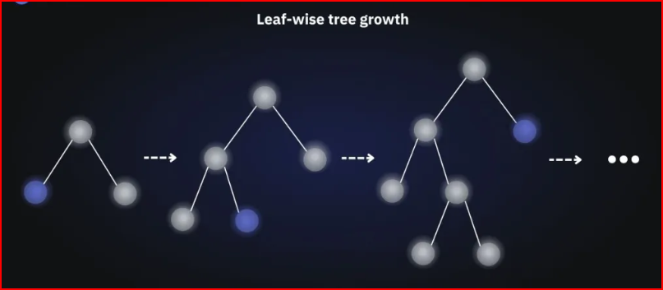

Slide 5
